Slide 1

A Project on Retail Superstore

Slide 2
Contents
Introduction
Data Source
Data Cleaning
Creating a Data Base
Visualizing Reports and telling Stories using tableau
Using Multiple Linear Regression Model to estimate sales for the future

Slide 3
1. Introduction
This project is about a retail store which sales products all over the world. The products are primarily furniture's, office supplies and appliances. The customers are broadly classified into three main categories i.e individuals, home office and corporate.
The data set available contains four years sales, quantities, shipping cost and profit.
The main objective of the project is to forecast sales and profit for the future based on last four years data using supervised machine learning, multiple linear regression model to be more specific.

Slide 4
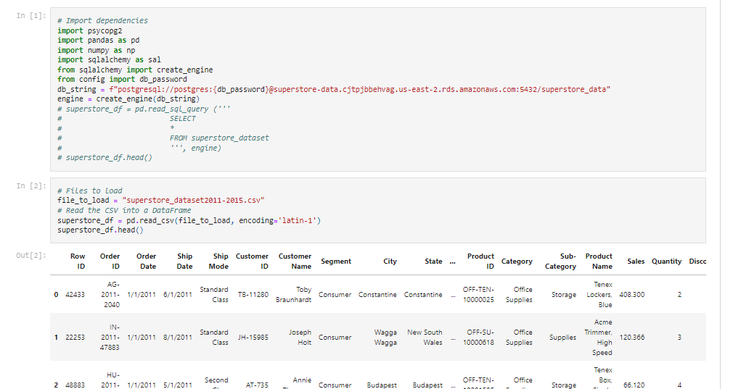
2. Data Source
We have used Kaggle.com to retrieve data set for the project.
The link to the data sources : https://www.kaggle.com/datasets/jr2ngb/superstore-data/code
Data set contains 24 columns and around 52K rows in flat file(csv).
The data downloaded from Kaggle is stored in AWS cloud in order to facilitate retrieval of data by all team members. Screen shot of connection to AWS.

Slide 5
3. Data Cleaning
We will start with data cleaning activity by importing csv file to Jupyter notebook.
The data cleaning mainly entails, dropping columns with null values, inserting columns to have year and month information, converting date columns to datetime format, getting total value of the discount etc.
The analysis of data set to understand distribution of sales over various customer segment, products and countries.
Unearth any hidden relationship between sales, profit , products, discount and customer segments.
Following assumptions made on the data set
Sales is gross sales
Profit is gross profit before discount and shipping cost

Slide 6
3.1 Data Cleaning in action
We have done following to clean the data set and added few columns relevant for the analysis; We have used Jupyter notebook to perform EDA
Converted shipping and order date types to datetime
Added a new column to get month year data from shipping date
Converted discount column to percentage and created a new column to get the amount of discount for each rows wherever discount rate is there.
We have assumed sales column as gross sales and inserted a column to get the unit sale price for each raw
We have added a column to get the unit cost price before discount and shipping charges, the unit cost price is derived by ( sales minus gross profit) divided by units sold.
We have dropped column containing postal code as most of the rows are blank

Slide 7
4. Creating a Data Base
We have established a link between Jupyter notebook and Pg admin to create a provisional database.
A table created in Pg admin to import cleaned data frame from Jupyter notebook to Pg admin
We have created queries in Pg admin to get information's like, total sales and profit by countries, total sales year on year, impact on profit if product sold without discount, top 10 profitable products etc
The cleaned data set in Pg admin is exported in csv format to visualize data in Tableau. We could have establish a connection from Pg admin to Tablaue if would have used paid version of Tablaue.

Slide 8
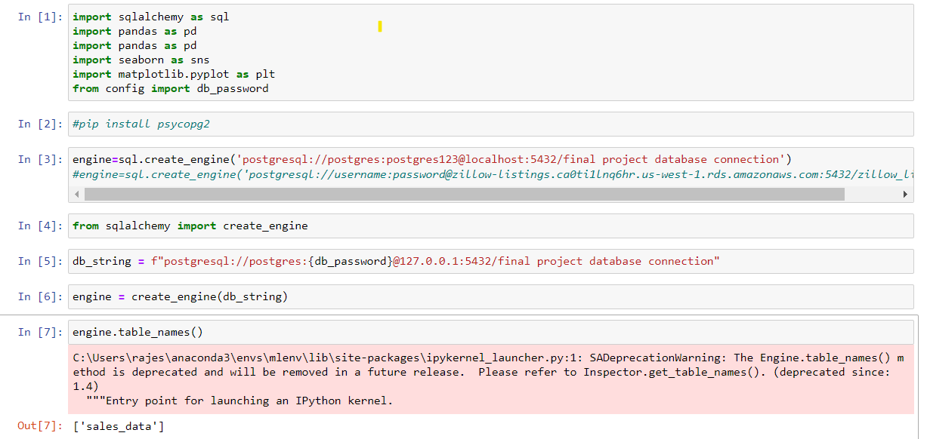
4.1 Creating a Data Base in action
A screen shot of connection from Jupyter note book to Pg admin

Slide 9
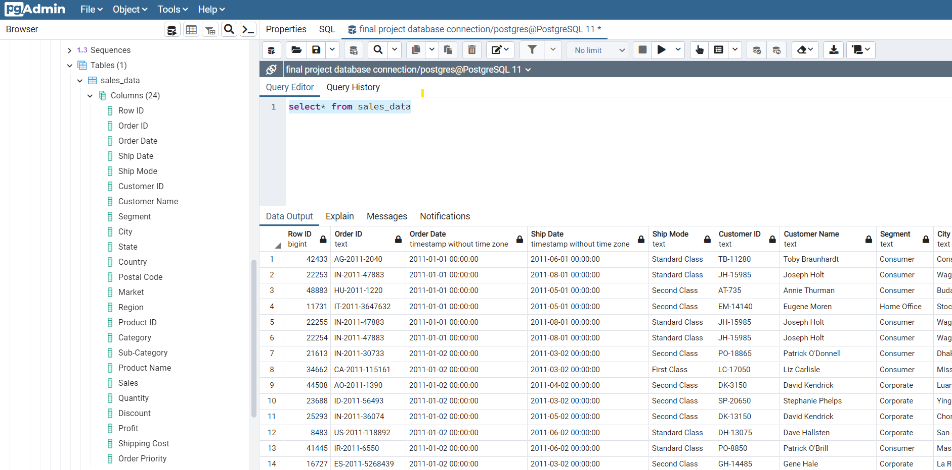
4.1 Creating a Data Base in action
A screen shot of data base created in Pg admin through engine created in Jupyter notebook

Slide 10
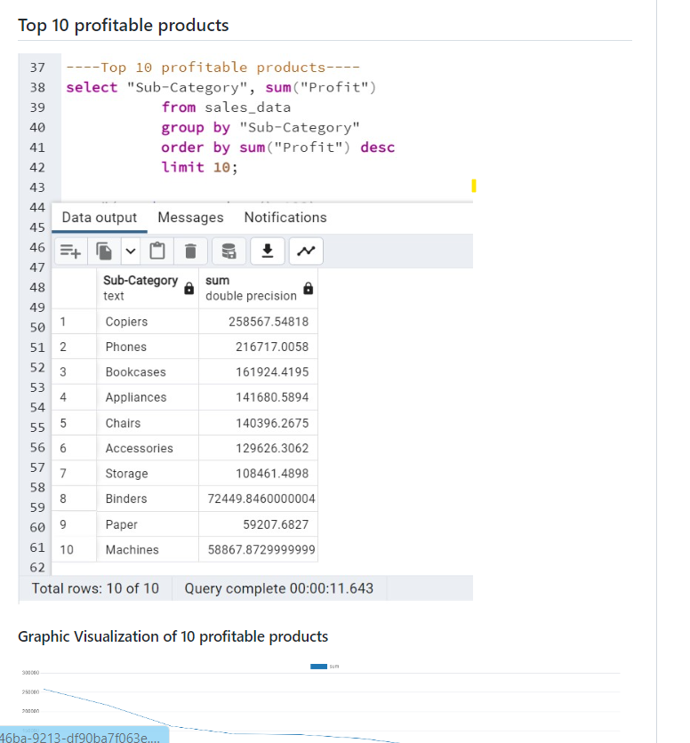
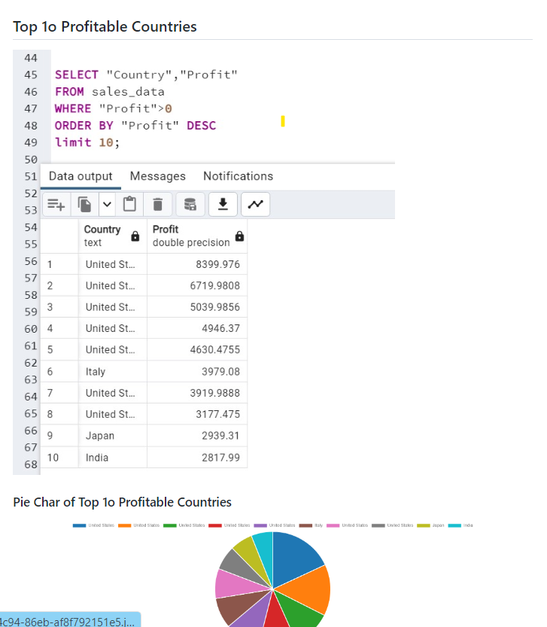
4.1 Creating a Data Base in action
Examples of queries ran in Pg admin

Slide 11
5. Visualizing Reports and Telling Stories Using Tableau
The database created in SQL (Pg Admin) is used to visualize information in Tableau.
Based on various reports visualized, we will create a story, explaining facts about the superstore i.e displaying revenue growth over time, customer profit analysis, distribution of revenue over various geographical locations etc.
Visualize sales over time to display trend to understand which months of the year we have higher sales and which months are characterized as slow sales. This will help to plan stocking of inventories to ensure we are not overstocking inventories when sales are slow and not understocking when sales are more during specific month of the year.

Slide 12
5.1 Visualizing Reports and Telling Stories Using Tableau – in action
We have created following dashboard to visualize performance of the store
Distribution of sales over various geographical area displaying in a world map
Profit by country
Sales by customer segment
Sale growth by year and month
Sales and profit by product
Profitability of the product
Profit by shipping method

Slide 13
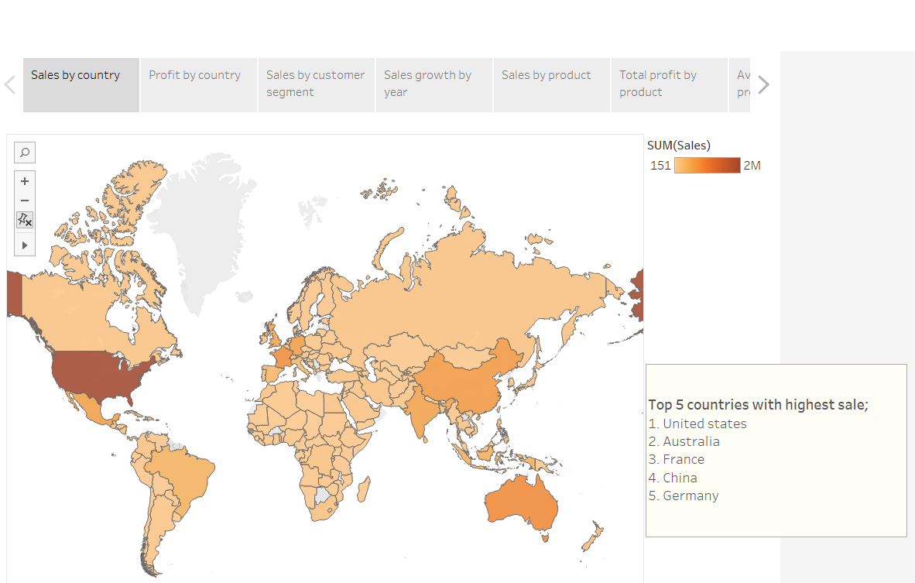
5.1 Visualizing Reports and Telling Stories Using Tableau – in action
Sales distribution over various geographical area

Slide 14
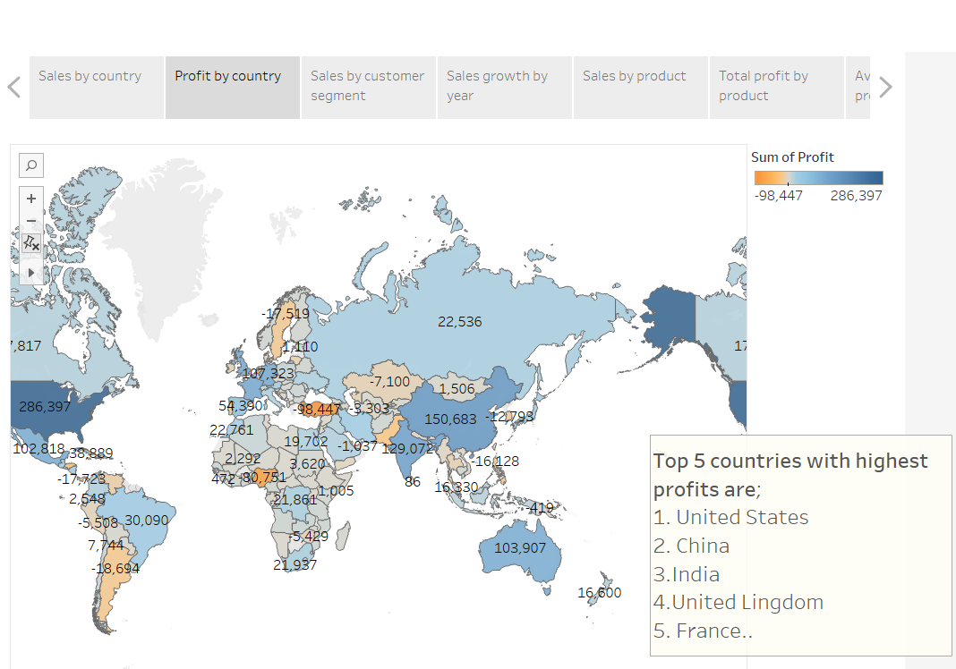
5.1 Visualizing Reports and Telling Stories Using Tableau – in action
Profit by countries

Slide 15
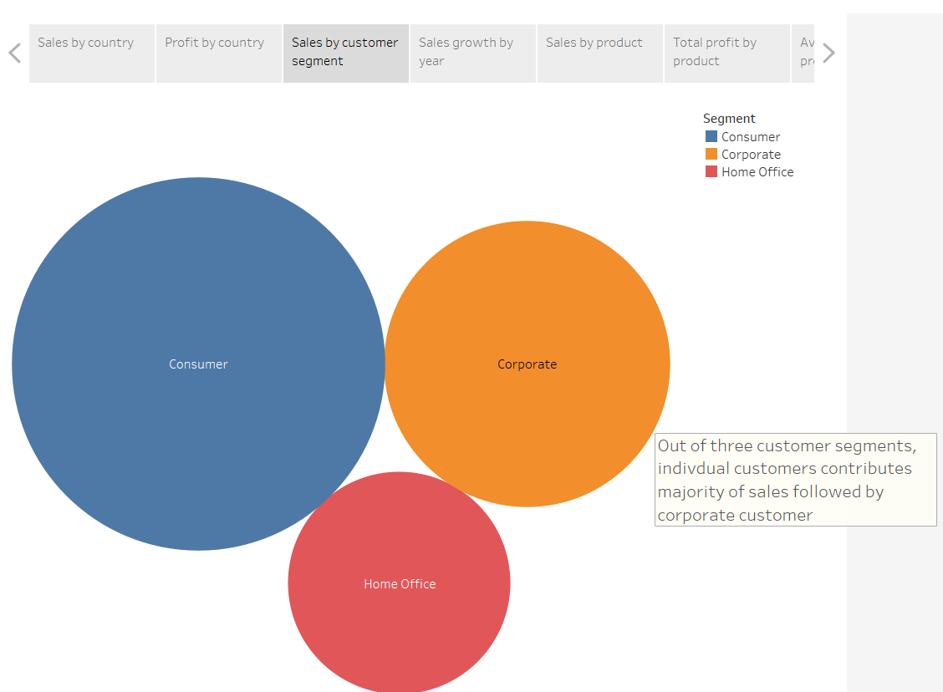
5.1 Visualizing Reports and Telling Stories Using Tableau – in action
Sales by customer segment

Slide 16
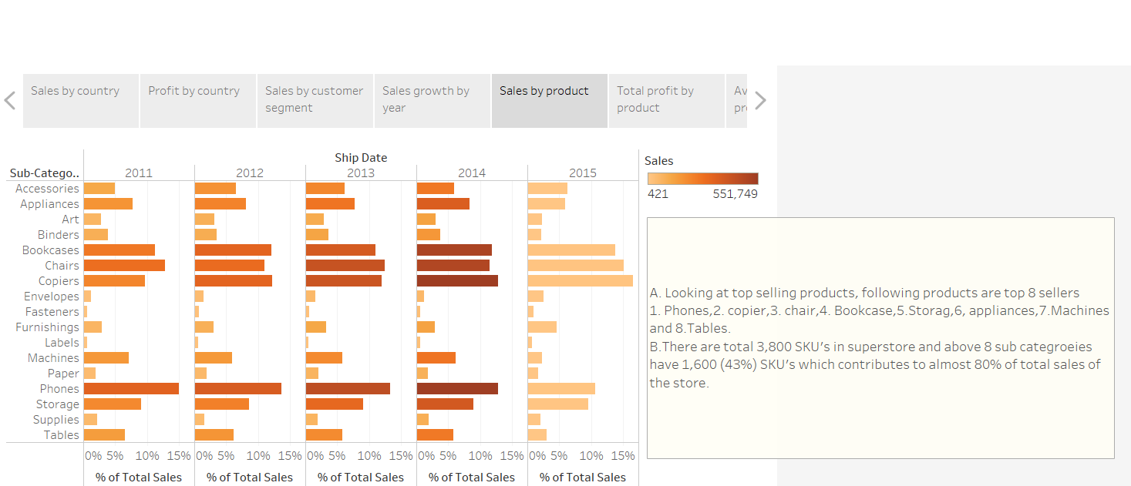
5.1 Visualizing Reports and Telling Stories Using Tableau – in action
Sales by product

Slide 17
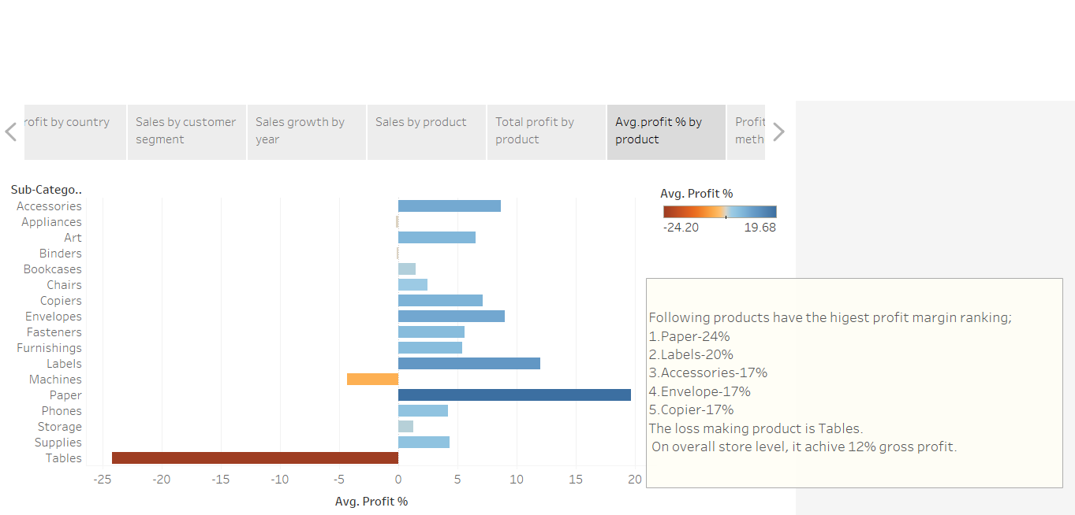
5.1 Visualizing Reports and Telling Stories Using Tableau – in action
Average profit % per product

Slide 18
6. Using machine learning Model to Estimate Sales for the Future
After we get a clean data set and understanding in depth the business trend, we will move on to predict sales forecast for the future.
Since data’s available for this project are discrete and have labels, we will use supervised learning model to predict sales for the future.
The most suitable model for this type of data set will be multiple liner regression model. We will initiate a liner regression model to plot sales(y axis) over time(X axis) and get a line of best fit
After we create a multiple liner regression model, we will use scikit-learn tool to train and test the model and get the accuracy of the mode.
After we satisfy with the machine learning model, we will link the model via flask and create a front end view using java script to enable user to input values to get the prediction of sales.

Slide 19
6.1 Using machine learning Model to Estimate Sales for the Future- In action
The clean data set generated in Pg admin is used to crate a machine learning model.
We have tried following machine learning models to select model which provide maximum accuracy.
Multiclass classification model
Multiple regression model and
Random forest model
After trying all the models mentioned above, we have found multiple regression model as the best model to predict sales as it give accuracy of 78%.

Slide 20
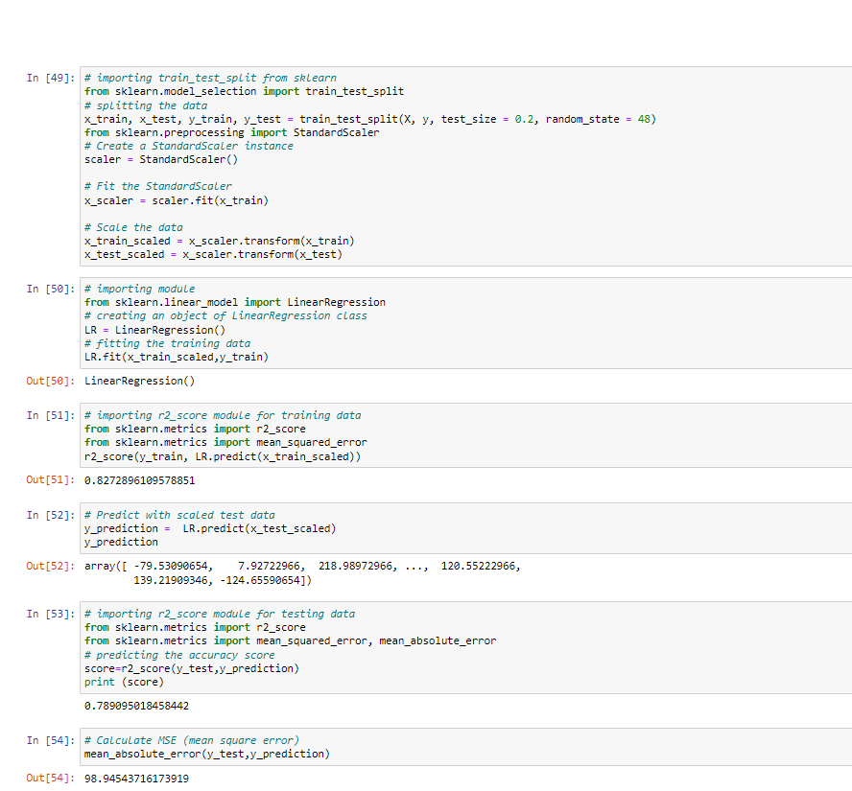
6.1 Using machine learning Model to Estimate Sales for the Future- In action
The screen shot of the model with 79% accuracy

Slide 21
Conclusion
This presentation serve a frame work for the project and guide team members to follow steps in order to achieve the milestones.
We will insert slides after we achieve each milestone to display outcome of the exercise.
………………………………….nothing follows------------------------------------------

